Slide 1
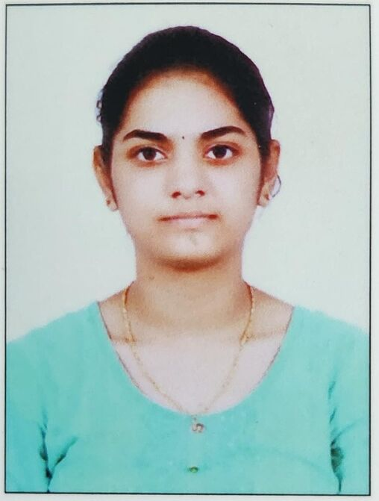
CAPSTONE PROJECT Empowering Navigation and Communication in Rural and Congested Regions Using Deep Learning Technologies.
Presented By
Student Name: Gurram Komali
College Name: Malla Reddy engineering college for women (mrecw)
Department: cse-aiml
Email ID:gurramkomali77@gmail.com
AICTE Student ID: STU664b44f9b4af11716208889

Slide 2
OUTLINE
Problem Statement
Proposed System/Solution
System Development Approach
Algorithm & Deployment
Result
Conclusion
Future Scope
References

Slide 3
Problem Statement
Road safety remains a crucial challenge in congested urban areas and low-infrastructure rural regions. Traffic signs often suffer from poor visibility, fading, or obstruction, making it difficult for drivers to recognize critical road information in real-time. Conventional traffic monitoring solutions fail to provide adaptive responses to diverse environmental and driving conditions. The objective of this project is to develop an intelligent traffic sign detection system powered by deep learning and voice assistance to enhance navigation and road safety.

Slide 4
Proposed Solution
The proposed system utilizes deep learning-based image recognition combined with natural language voice assistance to identify traffic signs and alert drivers in real time. The system consists of the following components:
Traffic Sign Detection: Employing CNN-based models for sign classification under different weather and lighting conditions.
Voice Assistance Integration: Using Natural Language Processing (NLP) to provide spoken alerts for detected signs.
GPS Navigation Enhancement: Merging the recognition system with location-based guidance for optimized real-time decision-making.
Deployment on Edge Devices: The solution will be optimized for mobile applications and IoT-based vehicle assistance systems.

Slide 5
System Approach
The system development follows a structured approach:
Data Collection: Gathering traffic sign images from various regions under diverse conditions.
Data Preprocessing: Enhancing images through contrast adjustments, noise removal, and edge detection.
Model Training: Using Convolutional Neural Networks (CNNs) trained on labeled traffic sign datasets.
Voice Assistant Module: Implementing NLP-based speech generation to provide driver alerts.
Integration with Navigation: Syncing traffic sign recognition with real-time GPS systems.
Testing & Validation: Evaluating system accuracy, response time, and deployment efficiency

Slide 6
Algorithm & Deployment
Algorithm Selection
CNN for Traffic Sign Detection
NLP for Speech-based Alerts
Data Input
Road sign image dataset
Weather, time, and environmental data
Training Process
Image classification using CNN layers
NLP-based speech model refinement
Prediction Process
Real-time detection via camera feed processing
Voice prompt generation for identified signs
Deployment
Embedded in mobile applications and IoT-based driver assistance systems
Cloud-based updates for continuous model training

Slide 7
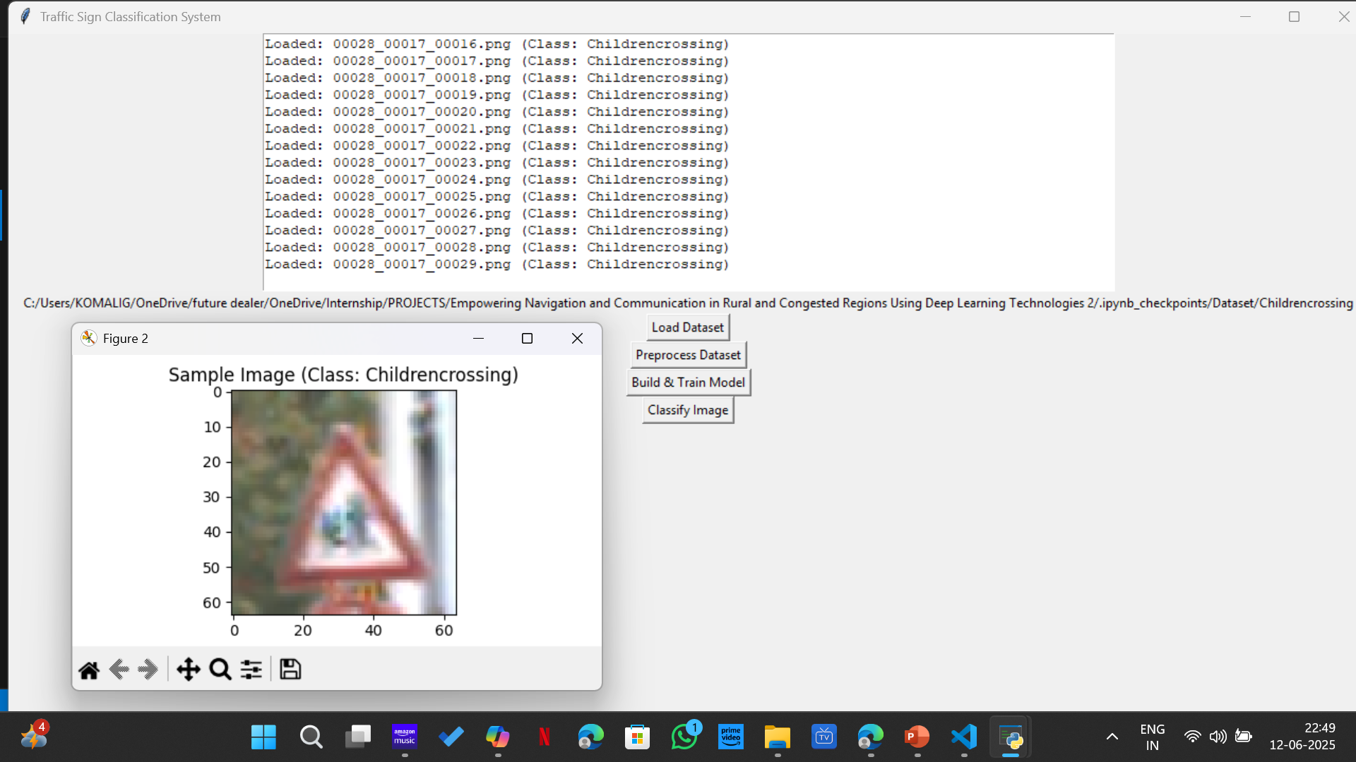
Result

Slide 8
Conclusion
This project presents a deep learning-powered traffic sign detection and voice guidance system, designed to improve road safety and driver assistance. By leveraging CNNs for image recognition and NLP for speech-based alerts, it provides real-time support to motorists navigating challenging environments.

Slide 9
Future scope
Expansion to Autonomous Vehicles: Integrating the system for self-driving cars.
Enhanced Sign Recognition: Adapting models to detect damaged or obscured signs.
Cloud-Based Continuous Learning: Using AI-driven updates for improved accuracy.
Multilingual Support: Offering speech-based alerts in multiple languages.
References
Research on CNN-based traffic sign detection.
Studies on AI-driven voice assistance systems.
Publications related to GPS and road navigation optimization.

Slide 10
References
Studies on AI-driven voice assistance systems.
Publications related to GPS and road navigation optimization.
Research on CNN-based traffic sign detection.
GitHub Link: KomaliG7/AI-Azure: Empowering Navigation and Communication in Rural and Congested Regions Using Deep Learning Technologies.

Slide 11
Thank you

